Slide 1
Agile Software Development

Slide 2
Rapid development and delivery is now often the most important requirement for software systems
Plan-driven development does not meet business needs(fast –changing requirement and software evolution)
Agile development methods emerged in the late 1990s

Slide 3
Problems in software development
Risks:
Schedule slips
Business misunderstood
Defect rate
Project cancelled
System goes sour
Business changes
Notes:
eg. Netscape 6
No communication after requirements analysis, or, Business needs changes
Time pressure, quality sacrificed for short-term speed gain
Bigger projects have good chance of being cancelled: low visibility, large budgets/timeframes
System delivered, works, but complex and/or fragile

Slide 4
Schedule slips
Many projects are not delivered on time
Examples: Word 1.0, Netscape 6
Some deadlines cannot be moved
Example: Y2K
What if:
most business value is delivered on time

Slide 5
Business misunderstood
Without direct communication, developers have to guess what the customer wants.
Example: The Orthodontics Project
What if:
an on-site customer steers development

Slide 6
Defect rate
The software is put in production, but the defect rate is so high that it isn’t used.
What if: you have automated testing

Slide 7
Project cancelled
Size of project
Early
On-Time
Delayed
Cancelled
Sum
1 function point
14.68%
83.16%
1.92%
0.25%
100.00%
10 function points
11.08%
81.25%
5.67%
2.00%
100.00%
100 function points
6.06%
74.77%
11.83%
7.33%
100.00%
1,000 function points
1.24%
60.76%
17.67%
20.33%
100.00%
10,000 function points
0.14%
28.00%
23.83%
48.00%
100.00%
100,000 function points
0.00%
13.67%
21.33%
65.00%
100.00%
Average
5.53%
56.94%
13.71%
23.82%
100.00%
Table 1: Percentage of projects early, on-time, late, canceled (from Patterns of Software Systems Failure and Success, by Capers Jones)
Notes:
Todo: function point
http://www.yourdon.com/books/y2k2020/11.dejavu.html

Slide 8
Project cancelled
What if:
short releases deliver at least some useful working software, reflecting investment to date

Slide 9
Business changes
New laws, market changes: business priorities change
What if:
the customer can change their mind, substitute functionality, and change priorities

Slide 10
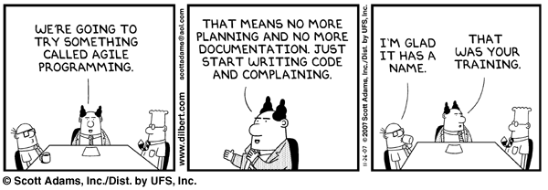
Agile development
Program specification, design and implementation are inter-leaved
The system is developed as a series of versions or increments with stakeholders involved in version specification and evaluation
Frequent delivery of new versions for evaluation
Extensive tool support (e.g. automated testing tools) used to support development.
Minimal documentation – focus on working code

Slide 11
Plan-driven and agile development
Agile method applicability: if developing a small or medium-sized product, commitment from the customer to become involved in the development process

Slide 12
The Manifesto for Agile Software Development
“We are uncovering better ways of developing software by doing it and helping others do it. Through this work we have come to value:
Individuals and interactions over processes and tools
Working software over comprehensive documentation
Customer collaboration over contract negotiation
Responding to change over following a plan
That is, while there is value in the items on the right, we value the items on the left more.”
agilemanifesto.org
Kent Beck et al

Slide 13
The principles of agile methods
Principle | Description
Customer involvement | Customers should be closely involved throughout the development process. Their role is provide and prioritize new system requirements and to evaluate the iterations of the system.
Incremental delivery | The software is developed in increments with the customer specifying the requirements to be included in each increment.
People not process | The skills of the development team should be recognized and exploited. Team members should be left to develop their own ways of working without prescriptive processes.
Embrace change | Expect the system requirements to change and so design the system to accommodate these changes.
Maintain simplicity | Focus on simplicity in both the software being developed and in the development process. Wherever possible, actively work to eliminate complexity from the system.

Slide 14
Extreme programming
Extreme Programming (XP) takes an ‘extreme’ approach to iterative development.
New versions may be built several times per day;
Increments are delivered to customers every 2 weeks;
All tests must be run for every build and the build is only accepted if tests run successfully
The extreme programming release cycle

Slide 15
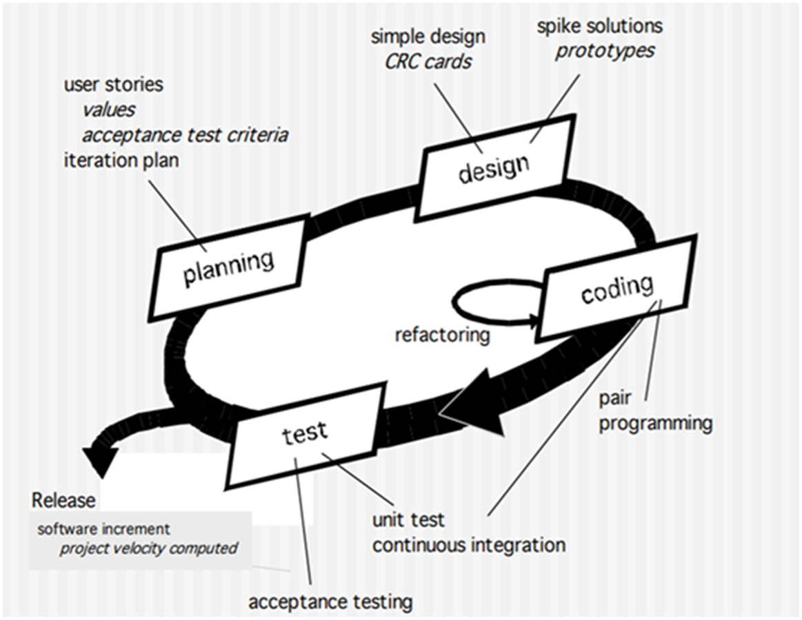

Slide 16
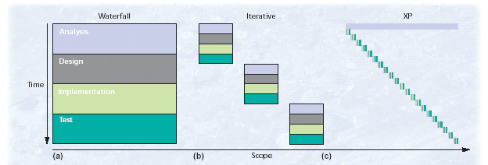
From Waterfall to Extreme Programming

Slide 17
Purpose of XP – Reduce the cost of change
Under certain circumstances, the exponential rise in the cost of changing software over time can be flattened. If we can flatten the curve, old assumptions about the best way to develop software no longer hold.
---- Traditional Cost of change ---- XP expected cost of change
Cost of change
Requirements Analysis Design Testing Implementation Production

Slide 18
Extreme programming practices (a)
Principle or practice | Description
Incremental planning | Requirements are recorded on story cards and the stories to be included in a release are determined by the time available and their relative priority. The developers break these stories into development ‘Tasks’. See Figures 3.5 and 3.6.
Small releases | The minimal useful set of functionality that provides business value is developed first. Releases of the system are frequent and incrementally add functionality to the first release.
Simple design | Enough design is carried out to meet the current requirements and no more.
Test-first development | An automated unit test framework is used to write tests for a new piece of functionality before that functionality itself is implemented.
Refactoring | All developers are expected to refactor the code continuously as soon as possible code improvements are found. This keeps the code simple and maintainable.

Slide 19
Extreme programming practices (b)
Pair programming | Developers work in pairs, checking each other’s work and providing the support to always do a good job.
Collective ownership | The pairs of developers work on all areas of the system, so that no islands of expertise develop and all the developers take responsibility for all of the code. Anyone can change anything.
Continuous integration | As soon as the work on a task is complete, it is integrated into the whole system. After any such integration, all the unit tests in the system must pass.
Sustainable pace | Large amounts of overtime are not considered acceptable as the net effect is often to reduce code quality and medium term productivity
On-site customer | A representative of the end-user of the system (the customer) should be available full time for the use of the XP team. In an extreme programming process, the customer is a member of the development team and is responsible for bringing system requirements to the team for implementation.

Slide 20
XP and agile principles
Incremental development is supported through small, frequent system releases.
Customer involvement means full-time customer engagement with the team.
People not process through pair programming, collective ownership and a process that avoids long working hours.
Change supported through regular system releases.
Maintaining simplicity through constant refactoring of code.

Slide 21
Influential XP practices
Extreme programming has a technical focus and is not easy to integrate with management practice in most organizations.
Consequently, while agile development uses practices from XP, the method as originally defined is not widely used.
Key practices
User stories for specification
Refactoring
Test-first development
Pair programming

Slide 22
User stories for requirements
Customer makes decisions on requirements
User requirements are stories or scenarios.
These are written on cards and broken down to tasks.
The customer chooses the stories for next release

Slide 23
Examples of task cards for prescribing medication

Slide 24
Refactoring
Rather than design for change, XP proposes constant code improvement (refactoring) to make changes easier when they have to be implemented.
Programming team makes improvements even where there is no immediate need for them. This improves code understanding and hence much documentation is not needed. Also Changes are easier to make.
Examples of refactoring
Re-organization of a class hierarchy to remove duplicate code.
Tidying up and renaming attributes and methods to make them easier to understand.
The replacement of inline code with calls to methods that have been included in a program library.

Slide 25
Refactoring example: Rename variable
public class Person {
private String firstName;
public void setFirst(String n) {
this.firstName = n;
}
}
Rename variable:
public class Person {
private String firstName;
public void setFirst(String firstName) {
this.firstName = firstName;
}
}

Slide 26
Refactoring example: Rename method
public class Person {
private String firstName;
public void setFirstName(String firstName) {
this.firstName = firstName;
}
}
The method has been refactored and is now more easily understandable.
Changing the method name requires you to change all references to the method throughout your application.
This is where a good IDE can help out, because it can identify all usages and update the calls automatically.

Slide 27
Test-first development
XP testing features:
Test-first development.
Incremental test development from scenarios.
User involvement in test development and validation.
Automated test harnesses are used to run all component tests each time that a new release is built.
Test-driven development
clarifies the requirements to be implemented.
Tests are written as programs such as Junit
All previous and new tests are run automatically when new functionality is added

Slide 28
Test case description for dose checking

Slide 29
Customer involvement:
The customer who is part of the team writes tests as development proceeds.
But people adopting the customer role have limited time available and reluctant since they may feel that providing the requirements was enough of a contribution.
Test automation:
Test automation means that tests are written as executable components before the task is implemented
As testing is automated, there is always a set of tests that can be quickly and easily executed

Slide 30
How to write tests?
All tests must be pass/fail style tests.
A bad test output:
Now Testing Person.java:
First Name: Tanner
Last Name: Burke
Age: 1
A good test output:
Now Testing Person.java:
Failure: Expected Age 2, but was 1 instead.

Slide 31
Writing tests
Grouping tests into test suites:
Now Testing Person.java:
Failure: Expected Age 2, but was 1 instead
Now Testing Account.java:
Passed!
Now Testing Deposit.java:
Passed!
Summary: 2 tests passed, 1 failed.
The entire suite of unit tests must always pass at 100% before any code is integrated into the source repository.
Acceptance tests do not have to pass at 100%.

Slide 32
Problems with test-first development
Programmers prefer programming to testing and sometimes they take short cuts when writing tests. For example, they may write incomplete tests that do not check for all possible exceptions that may occur.
Some tests can be very difficult to write incrementally. For example, in a complex user interface, it is often difficult to write unit tests for the code that implements the ‘display logic’ and workflow between screens.
It difficult to judge the completeness of a set of tests. Although you may have a lot of system tests, your test set may not provide complete coverage.

Slide 33
Pair Programming
All programming is done with two coders at the same machine.
The programmers must share one mouse, keyboard, screen, etc.
→ At least two people are always intimately familiar with every part of the system, and every line of code is reviewed as it's written.

Slide 34
Here is how pair programming works:
You pick out a user story for your next task.
A user story is a requirement from the customer. Stories are typically written on index cards, and the customer decides which stories are the most important.
You ask for help from another programmer.
The two of you work together on a small piece of functionality.
Try to work on small tasks that take a few hours.
After the immediate task is complete, pick a different partner or offer to help someone else.
Eric Burke and Brian Coyner

Slide 35
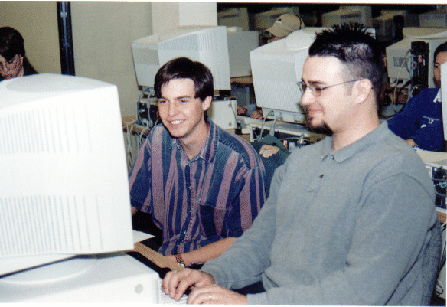
Pair Programming http://www.pairprogramming.com/
Pair-programming has been popularized by the eXtreme Programming (XP) methodology
With pair-programming:
Two software engineers work on one task at one computer
One engineer, the driver, has control of the keyboard and mouse and creates the implementation
The other engineer, the navigator, watches the driver’s implementation to identify defects and participates in on-demand brainstorming
The roles of driver and observer are periodically rotated between the two software engineers

Slide 36
Pair programming
Pair programming involves programmers working in pairs, developing code together.
This helps develop common ownership of code and spreads knowledge across the team.
It serves as an informal review process as each line of code is looked at by more than 1 person.
It encourages refactoring as the whole team can benefit from improving the system code.
programmers sit together at the same computer to develop
Pairs are created dynamically so that all team members work with each other
The sharing of knowledge reduces the overall risks to a project when team members leave.
there is some evidence that suggests that a pair working together is more efficient than 2 programmers working separately.

Slide 37
Agile project management

Slide 38
Agile project management
The principal responsibility of software project managers is to manage the project
The standard approach to project management is plan-driven.
Agile project management requires a different approach, which is adapted to incremental development and the practices used in agile methods.
Scrum
Scrum is an agile method that focuses on managing iterative development rather than specific agile practices.

Slide 39

Intro of Agile Scrum
Scrum is a development methodology commonly used to oversee projects. Below figure represent agile example.

Slide 40
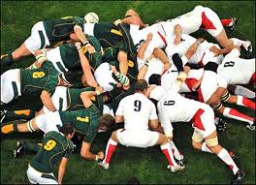
Scrum
Originally proposed by Schwaber and
Beedle
Scrum—distinguishing features
Development work is partitioned into “packets”
Testing and documentation are on-going as the product is constructed
Work occurs in “sprints” and is derived from a “backlog” of existing requirements
Meetings are very short and sometimes conducted without chairs
“demos” are delivered to the customer with the time-box allocated
Currently seems to have overtaken XP as most popular

Slide 41
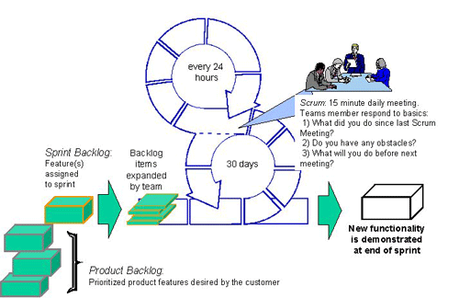
Scrum

Slide 42
Scrum
There are three phases in Scrum.
The initial phase is an outline planning phase where you establish the general objectives for the project and design the software architecture.
This is followed by a series of sprint cycles, where each cycle develops an increment of the system.
The project closure phase wraps up the project, completes required documentation such as system help frames and user manuals and assesses the lessons learned from the project

Slide 43
Scrum terminology (a)
Scrum term | Definition
Development team | A self-organizing group of software developers, which should be no more than 7 people. They are responsible for developing the software and other essential project documents.
Potentially shippable product increment | The software increment that is delivered from a sprint. The idea is that this should be ‘potentially shippable’ which means that it is in a finished state and no further work, such as testing, is needed to incorporate it into the final product. In practice, this is not always achievable.
Product backlog | This is a list of ‘to do’ items which the Scrum team must tackle. They may be feature definitions for the software, software requirements, user stories or descriptions of supplementary tasks that are needed, such as architecture definition or user documentation.
Product owner | An individual (or possibly a small group) whose job is to identify product features or requirements, prioritize these for development and continuously review the product backlog to ensure that the project continues to meet critical business needs. The Product Owner can be a customer but might also be a product manager in a software company or other stakeholder representative.

Slide 44
Scrum term | Definition
Scrum | A daily meeting of the Scrum team that reviews progress and prioritizes work to be done that day. Ideally, this should be a short face-to-face meeting that includes the whole team.
ScrumMaster | The ScrumMaster is responsible for ensuring that the Scrum process is followed and guides the team in the effective use of Scrum. He or she is responsible for interfacing with the rest of the company and for ensuring that the Scrum team is not diverted by outside interference. The Scrum developers are adamant that the ScrumMaster should not be thought of as a project manager. Others, however, may not always find it easy to see the difference.
Sprint | A development iteration. Sprints are usually 2-4 weeks long.
Velocity | An estimate of how much product backlog effort that a team can cover in a single sprint. Understanding a team’s velocity helps them estimate what can be covered in a sprint and provides a basis for measuring improving performance.

Slide 45
Scrum sprint cycle

Slide 46
Problem statement
In traditional methodology Some vital changes are being made in project and feel difficulty, and during an application in the testing Stage, it is very difficult to go back and do some eminent changes. One may Go to come across large projects with expensive cost.
Customer not involvement during any phase.
Change mind for changing requirement in srs is so difficult
After project execution Customer satisfaction is less than expected.
Tradition methodology Continuous planning for project is the biggest problem.

Slide 47
Goal
All problems occurring during traditional methodology phases are fixed using Case study on (shopping cart) project with agile scrum methodology.

Slide 48
Life cycle of case Study contains following steps
Product Backlog.
Sprint Planning Meeting.
Sprint Backlog.
Daily Scrum.
Results.
Sprint Review Meeting.
Release Burn chart.

Slide 49
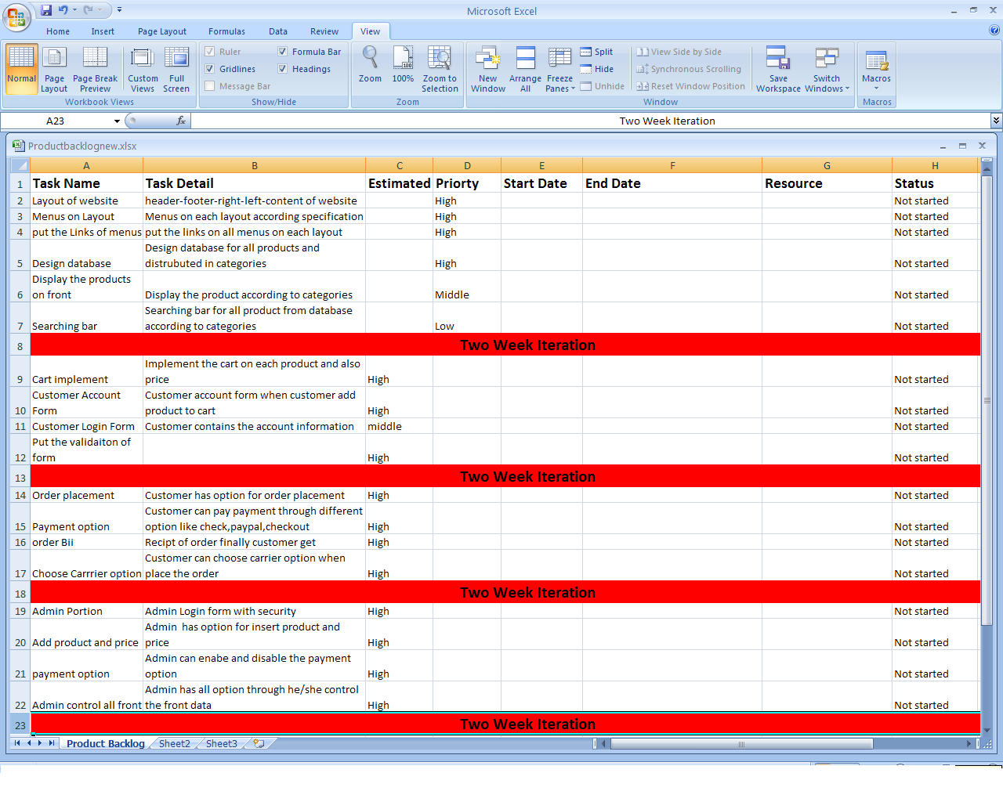
Product Backlog
The Product Backlog is the master list of all functionality desired in the product. When using Scrum, it is not necessary to start a project with a lengthy, upfront effort to document all requirements.

Slide 50
Sprint Planning meeting
The Sprint Planning Meeting is attended by the Product Owner, the entire Scrum Team.
During the sprint planning meeting the Product Owner describes the highest priority features to the team.
The Product Owner doesn't have to describe every item being tracked on the Product Backlog.

Slide 51
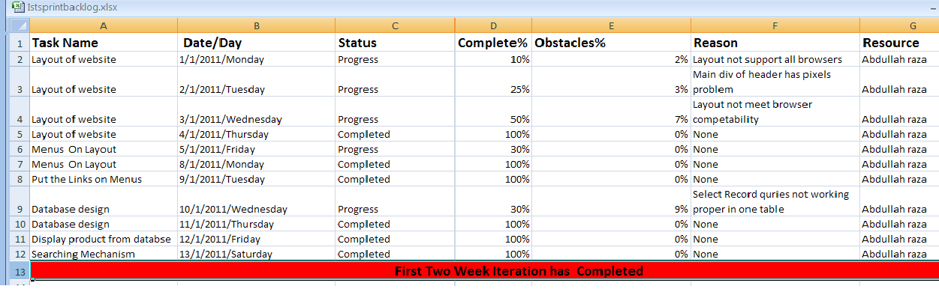
Sprint backlog of First Iteration

Slide 52
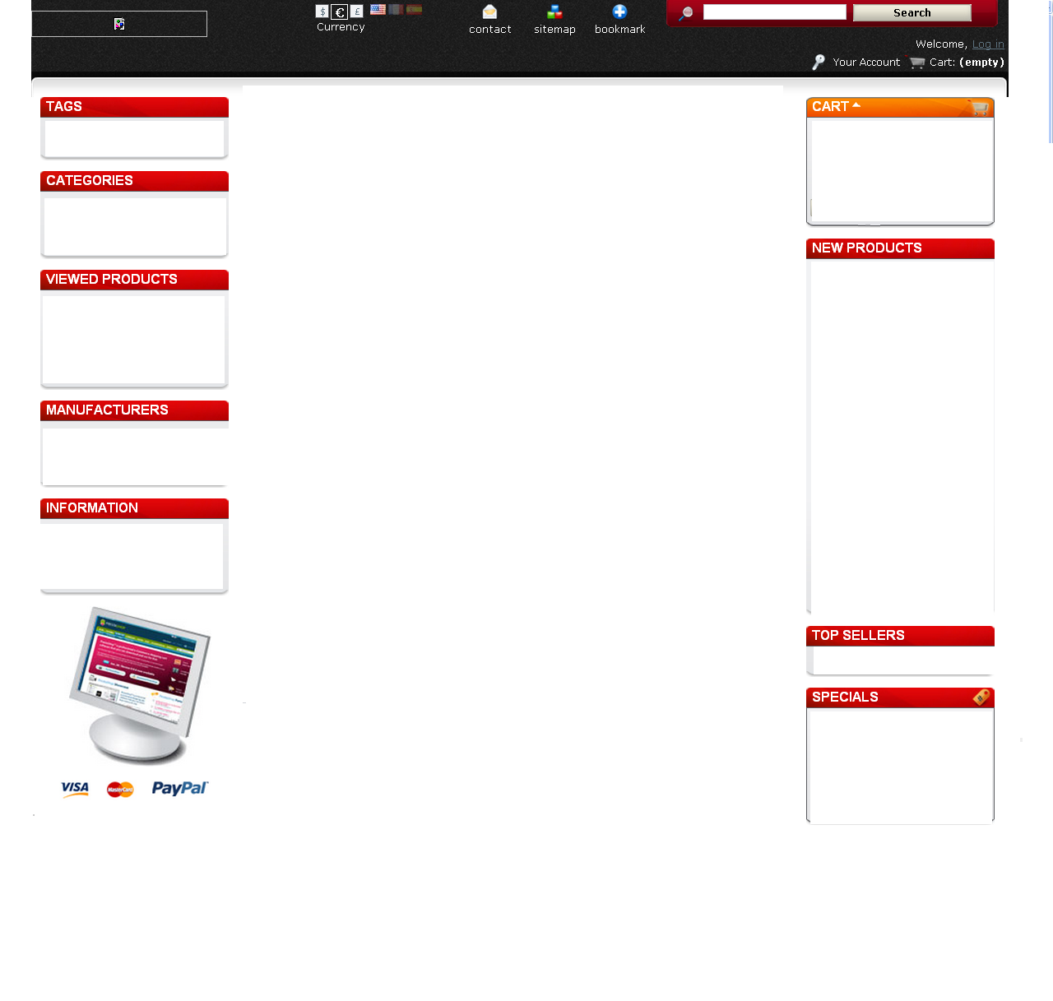
Layout of website

Slide 53
Daily Scrum
Team members involve in this meeting on the following seniors.
Time:
20-minutes
Three questions:
What did you do yesterday
What will you do today?
What obstacles are in your way?

Slide 54
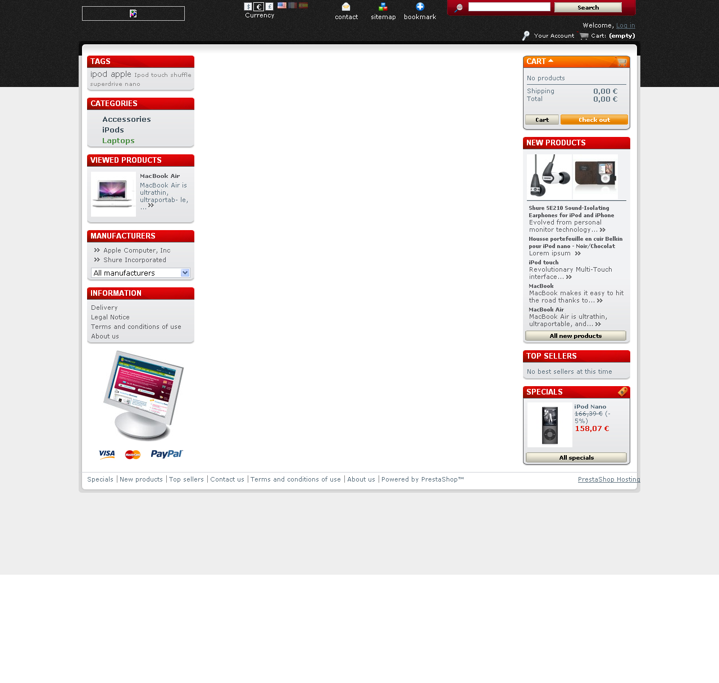
Menus on Layout

Slide 55

Links on Menus Layout

Slide 56
Display products on main page

Slide 57
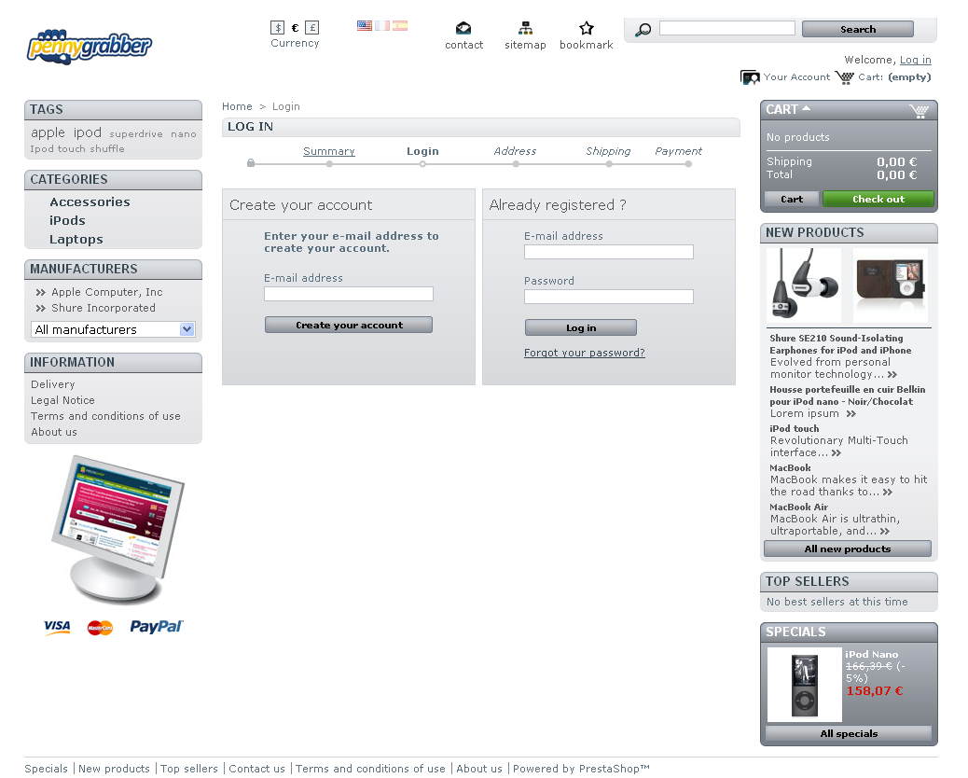
Customer account form

Slide 58
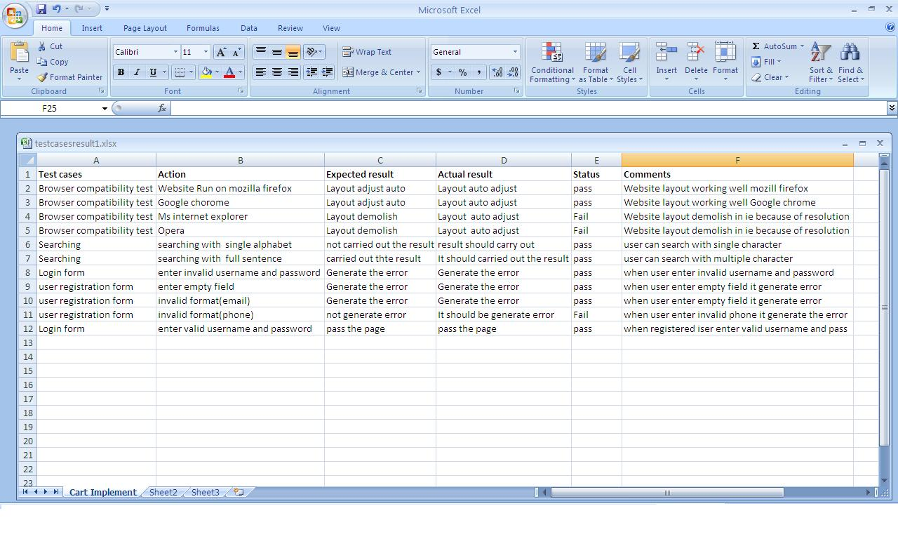
Test case Iteration one

Slide 59
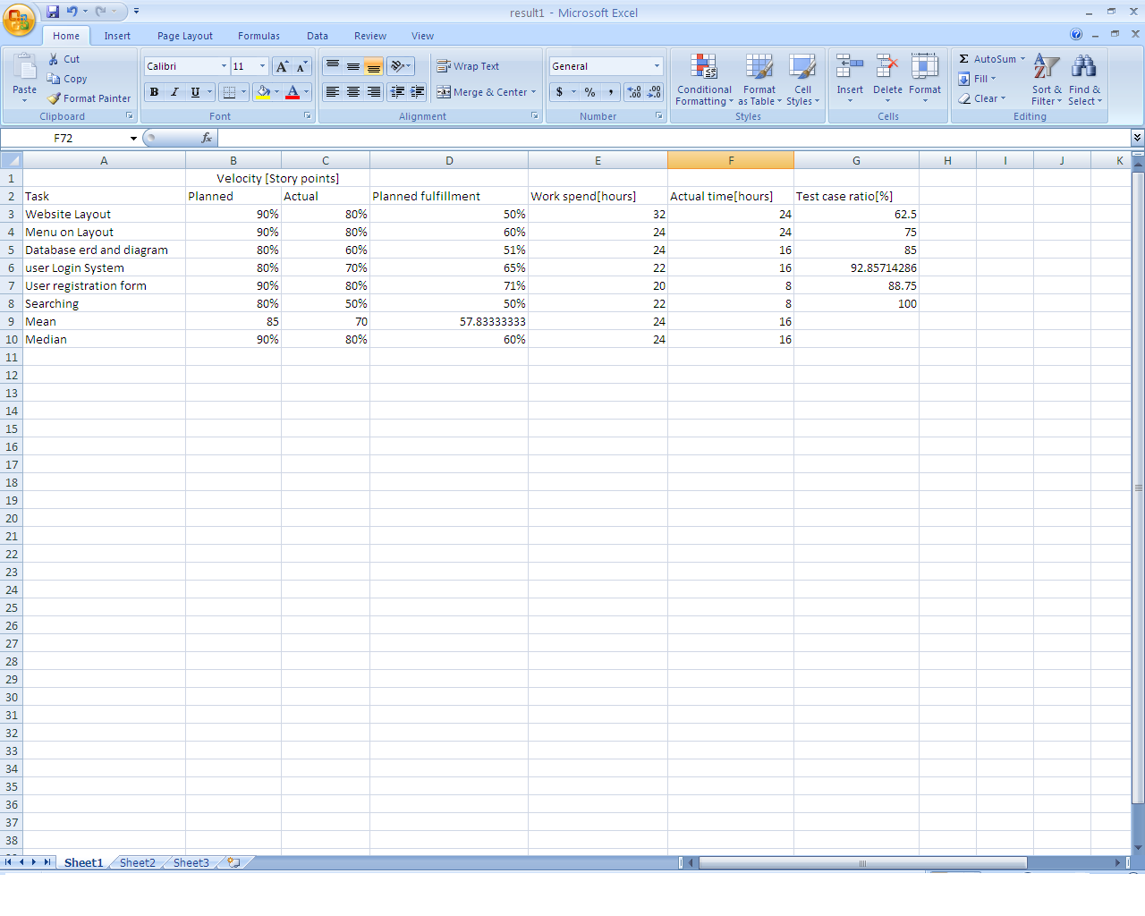
Results of First two weeks Iteration

Slide 60
Sprint Review Meeting
Team presents what it accomplished during the sprint
Typically takes the form of a demo of new features or underlying architecture
Informal
2-hour prep time rule
Participants
Customers
Management
Product Owner
Other engineers

Slide 61
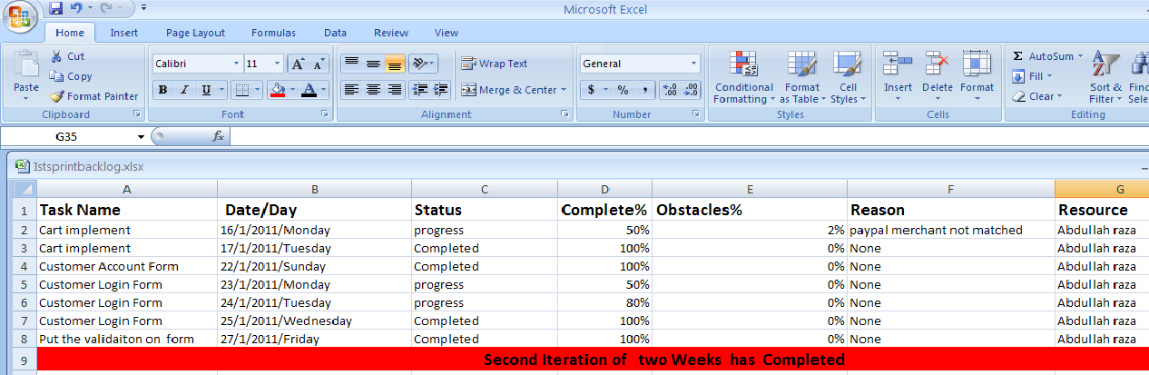
Sprint backlog of second iteration

Slide 62

Cart implement

Slide 63

Customer Account Form

Slide 64

Customer filled the form

Slide 65
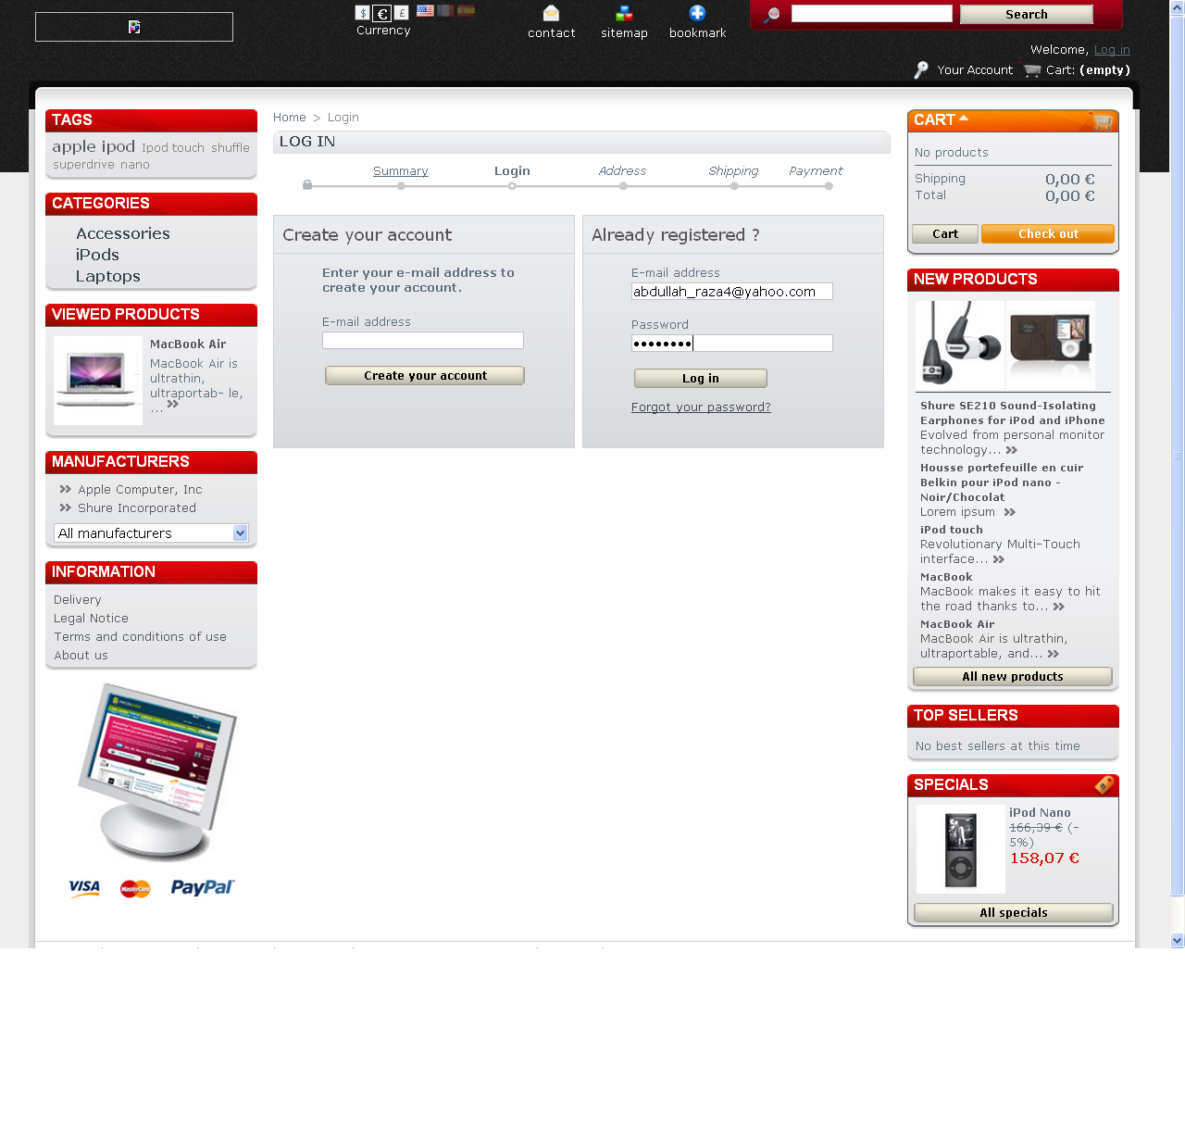
Customer Login

Slide 66
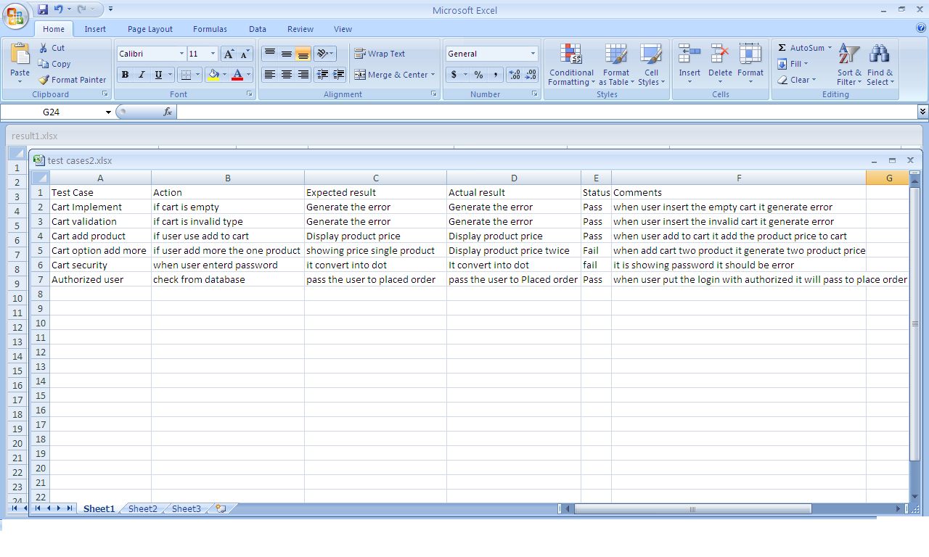
Test Case 2

Slide 67
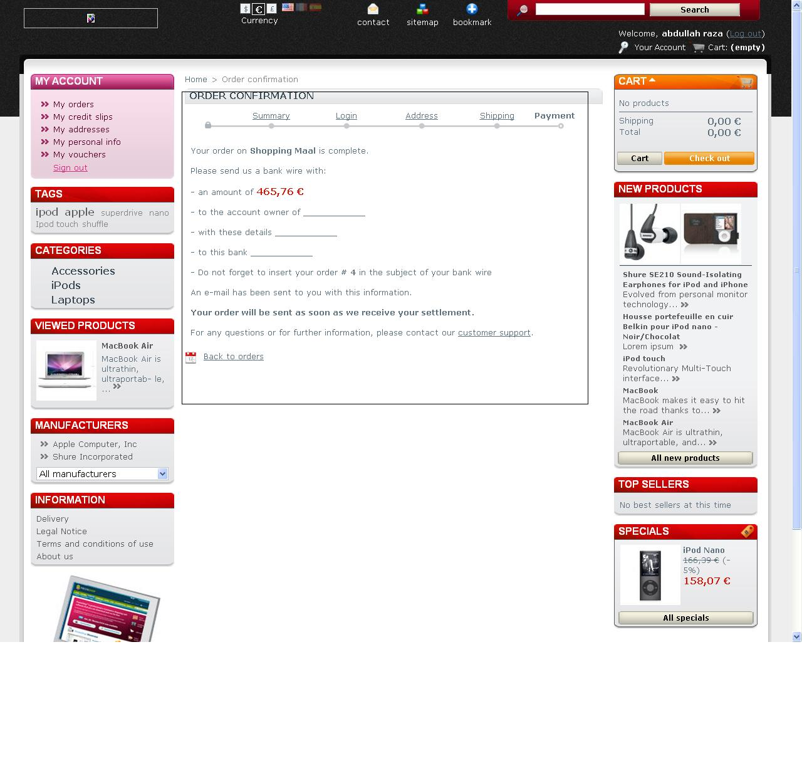
Final receipt in pdf

Slide 68
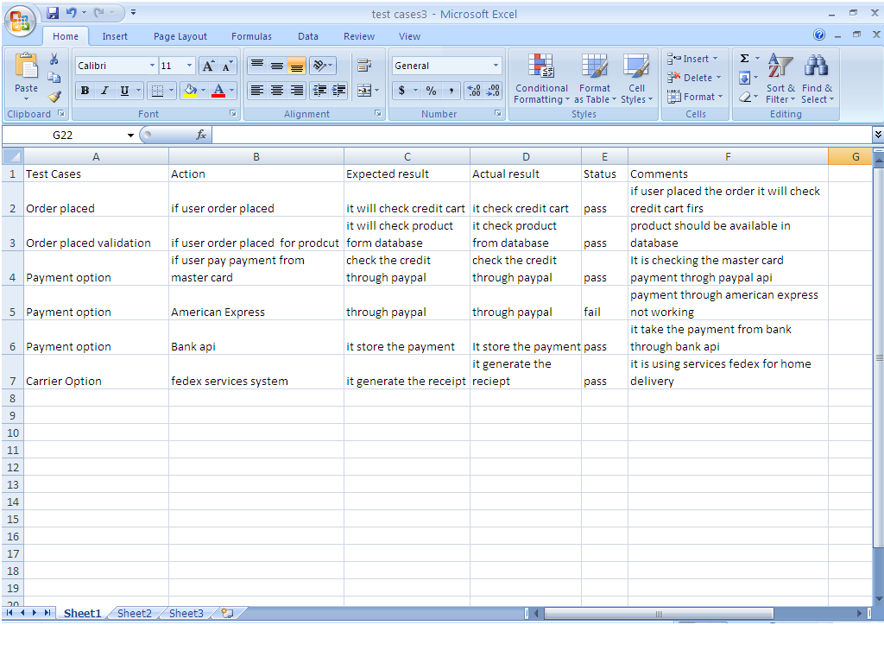
Test case 3

Slide 69
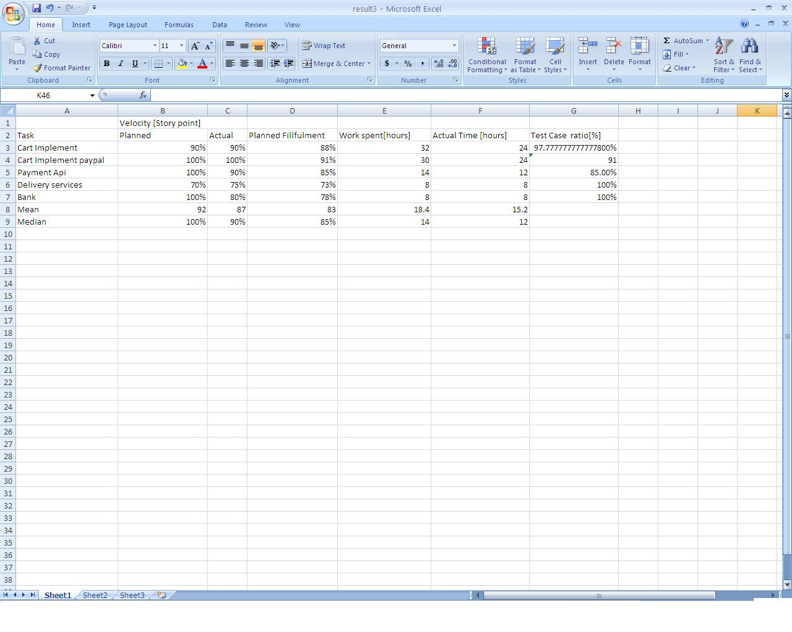
Results of iteration three

Slide 70
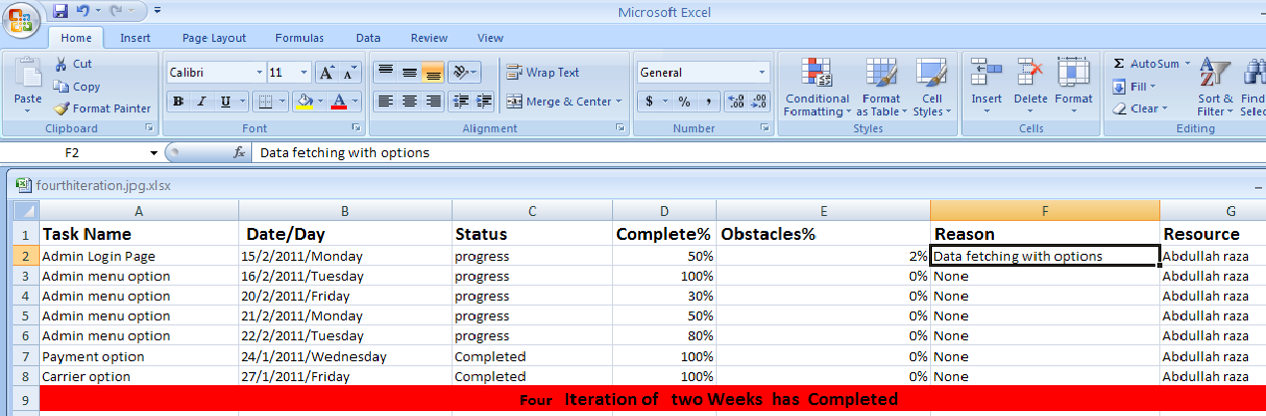
Four iteration of sprint backlog

Slide 71
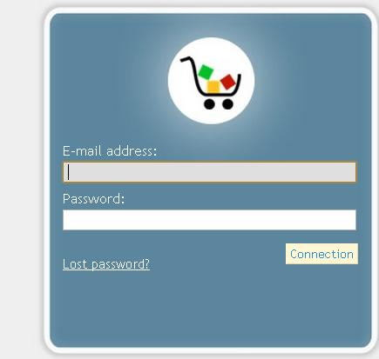
Admin Login Form

Slide 72
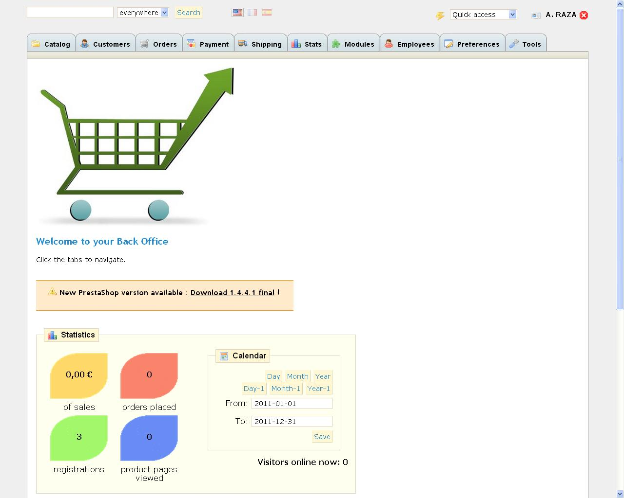
Admin panel with menus

Slide 73
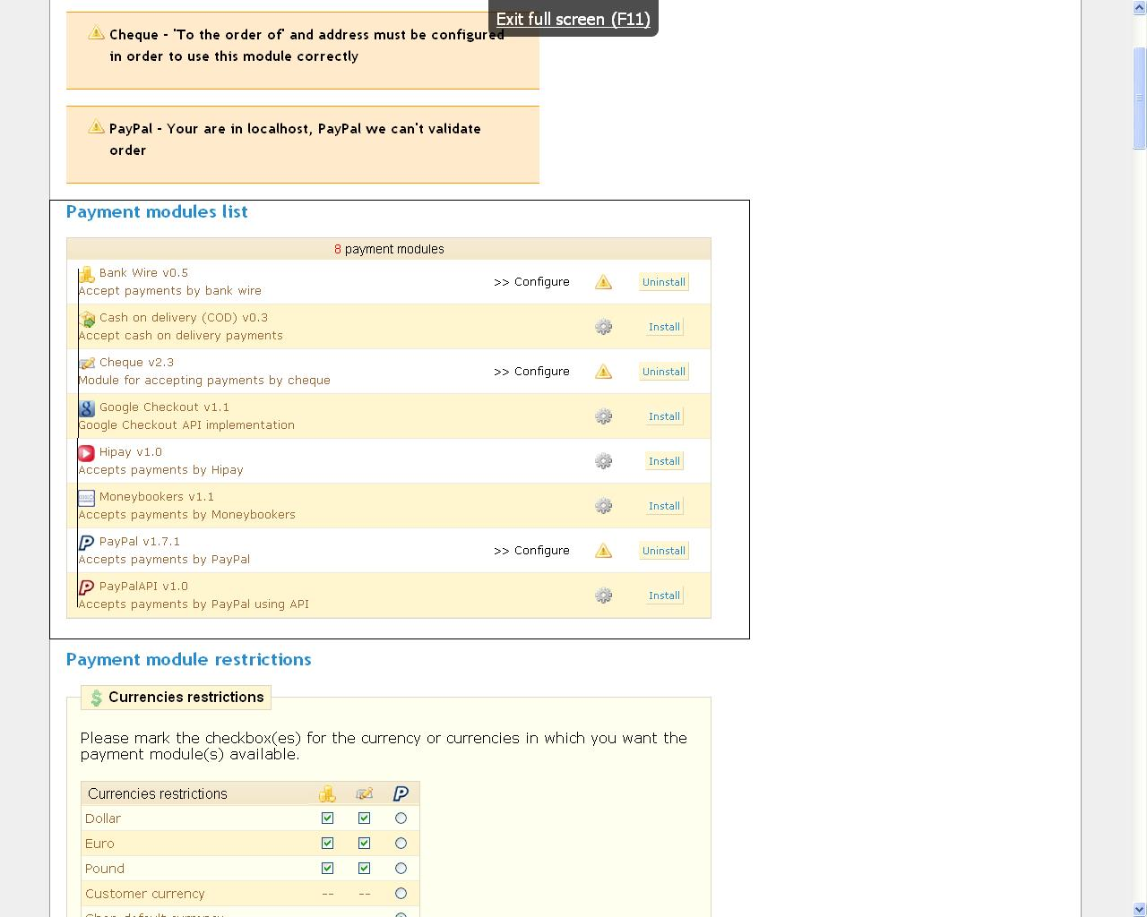
Payment panel

Slide 74
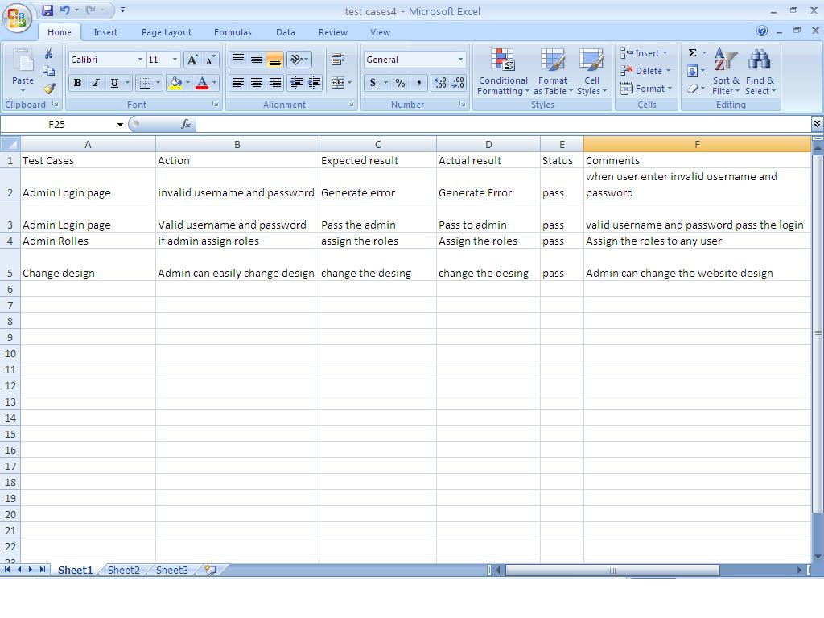
Test case 4

Slide 75
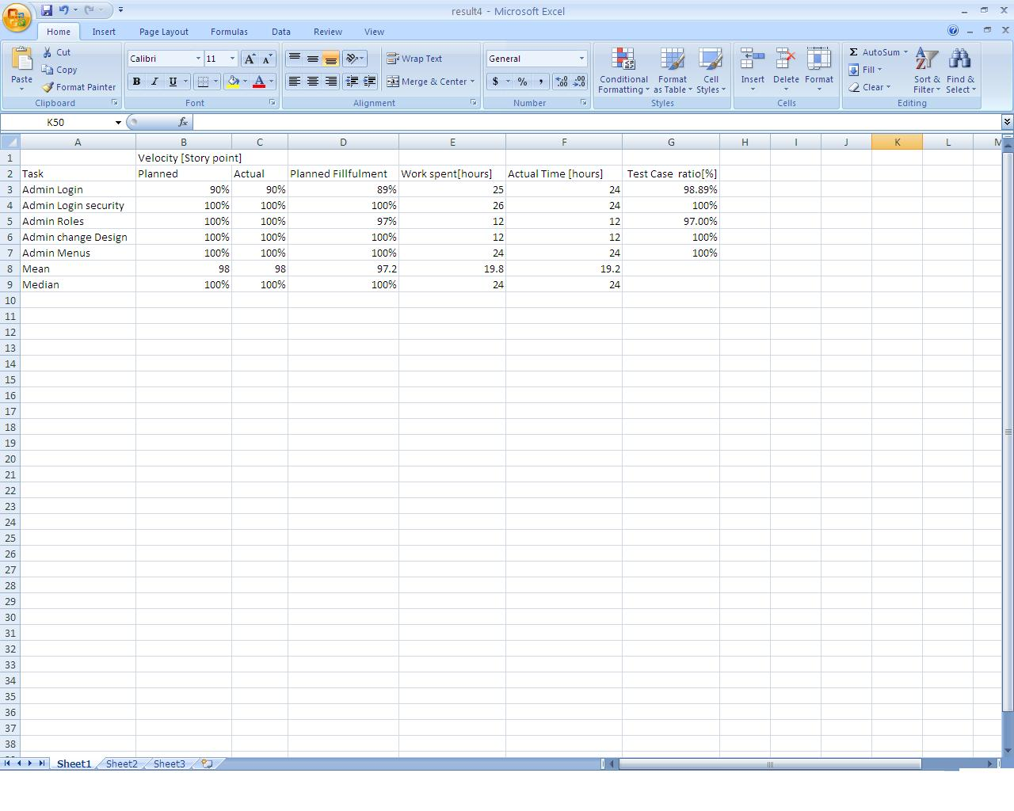
Results of four iteration

Slide 76
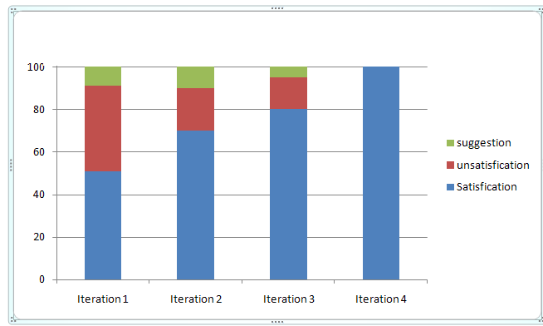
Customer satisfaction graph

Slide 77
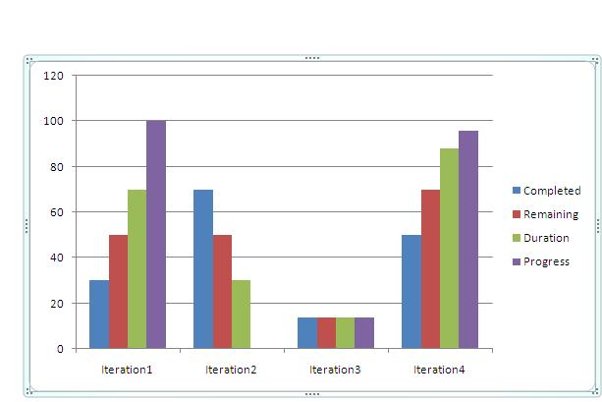
RELEASE BURNDOWN
On a Scrum project, the team tracks its progress against a release plan by updating a release burn down chart at the end of each sprint. The horizontal axis of the release burn down chart shows the sprints months; the vertical axis shows the amount of work complete.

Slide 78
Scrum benefits
The product is broken down into a set of manageable and understandable chunks.
Unstable requirements do not hold up progress.
The whole team have visibility of everything and consequently team communication is improved.
Customers see on-time delivery of increments and gain feedback on how the product works.
Trust between customers and developers is established and a positive culture is created in which everyone expects the project to succeed.

Slide 79
Distributed Scrum

Slide 80
Conclusion
Sprint to Sprint check the progress of web project
Customer involve at the end of every sprint
Requirements can recharge easily.
Customer can change his/her mind at the end of sprint
Planning is proper sprint to sprint and get idea for next iteration.
Proper planning in each sprint get idea for good planning for next iteration.
Functionality is improve on each stage.
Short term sprint is better than long term duration.
Changing requirements is very easy at the end of sprint.

Slide 81
References
[1] A Case Study on Agile Estimating and Planning using Scrum
V. Manic (research paper) 2011.
[2] Stephen Schacht Classical and Object-Oriented Software
Engineering. 6/e, WCB McGraw Hill, New York, (white paper)2010.
[3] Schatz B., Abdul shafi I. Primavera Gets Agile: A Successful
Transition to Agile Development (white paper)2011.
[4] Gerber, Aurona; Van der Merwe, Alta; Alberts, Ronell,
Implications of Rapid Development Methodologies, CSITEd ,
Mauritius (research paper)2011.
[5] Yatco, Mei Agile Joint Application/development. University of
Missouri-St. Louis (research paper)2011.
[6] Schell Jesse "Chapter Seven: The Game Improves Through
scrum Iteration". The Art of Game .Design. Elsevier. pp. 79–95.
ISBN 978-0-12- 369496-6 2010.
[7] Carver J. Shull F. A checklist for integrating student empirical studies with research and
teaching goals // Empirical Software Engineering, (research paper) 2010.

